Slide 1

Model Building for Sentiment Analysis using Machine Learning
Guided By-
Dr. S. S. Dhande
Presenter-
Shubham Bihure

Slide 2
Content
Introduction
Machine Learning Algorithms
SVM
Decision Tree
Neutral Network
Comparative Analysis
Conclusion
References

Slide 3
Introduction
Welcome to the presentation on Model Building for Sentiment Analysis using Machine Learning.
In this session, we will explore and compare various Machine Learning algorithms for sentiment analysis, including Naive Bayes, Support Vector Machines, Decision Trees, and Neural Networks.

Slide 4
Sentiment Analysis is a data-driven approach to uncovering emotions and opinions from textual data.
Understanding the process of extracting emotions and opinions from textual data.
Importance of Sentiment Analysis: How it aids decision-making and customer satisfaction in various domains.

Slide 5
How to create a machine learning model?
Machine learning models are created by training algorithms with either labeled or unlabeled data, or a mix of both.
As a result, there are three primary ways to train and produce a machine learning algorithm:
Supervised learning
Unsupervised learning
Semi-supervised learning

Slide 6
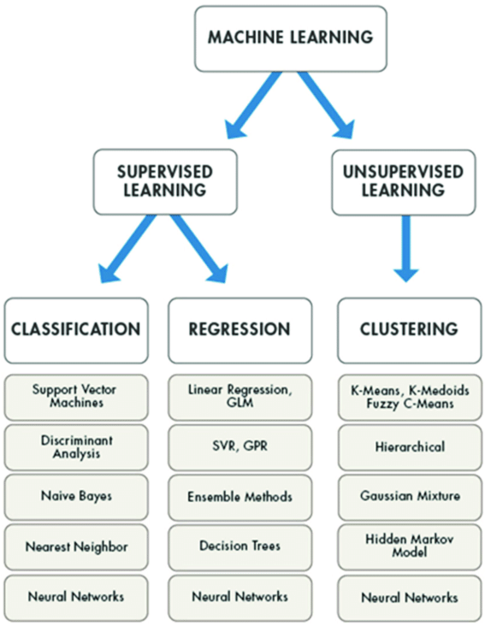
Types of Machine Learning Models:
Classification models:
Logistic regression
Naive Bayes
Decision trees
Random forest
K-nearest neighbor (KNN)
Support vector machine
Regression models:
Linear regression
Ridge regression
Decision trees
Random forest
K-nearest neighbor (KNN)
Neural network regression

Slide 7
Machine Learning Algorithms
Support Vector Machines (SVM): Effective for binary and multi-class classification, capable of handling high-dimensional data.
Decision Trees: Recursive partitioning of data based on feature values, offering interpretability.
Neural Networks: Deep learning models that capture complex patterns and relationships in data.

Slide 8
Support Vector Machines (SVM)
Support Vector Machines (SVM) are powerful classifiers used for Sentiment Analysis.
SVM is a supervised learning algorithm that finds hyperplanes to separate sentiment classes in high-dimensional space.
Hyperplanes: SVM aims to maximize the margin between data points of different classes.

Slide 9
Pros of SVM:
Effective for binary and multi-class classification.
Works well in high-dimensional spaces.
Good generalization capabilities.
Cons of SVM:
Computationally intensive, especially for large datasets, which make it slower of training and prediction.
Choosing the right kernel function is crucial for performance.

Slide 10


Slide 11
Decision Trees
Decision Trees are intuitive models used in Sentiment Analysis.
Understanding Decision Trees: They recursively partition the data based on feature values, forming a tree-like structure.
Feature Selection: Decision Trees use features to make binary decisions at each node.

Slide 12
Advantages of Decision Trees:
Easy to interpret and visualize.
Can handle both numerical and categorical data.
Disadvantages of Decision Trees:
Prone to overfitting, especially for complex trees.
Sensitive to small changes in data, leading to instability.

Slide 13


Slide 14
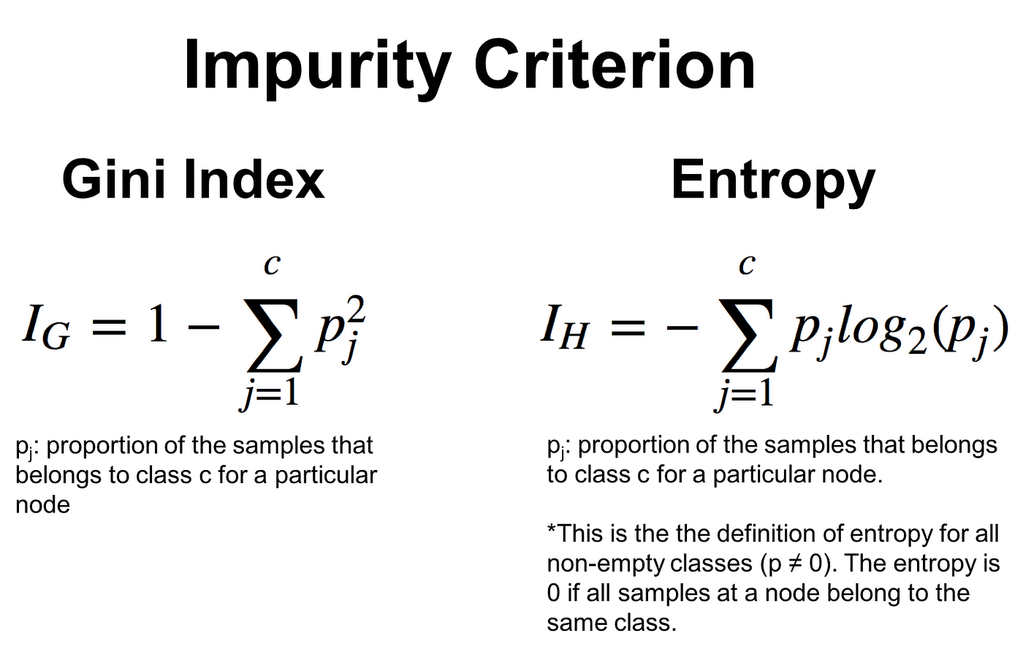

Slide 15
Neural Networks
Neural Networks are a class of Deep Learning models for Sentiment Analysis.
Introduction: Neural Networks capture complex patterns and relationships in textual data.
Deep Learning Approach: Multiple hidden layers enable learning of abstract features

Slide 16
Strengths of Neural Networks:
High accuracy for complex tasks, including Sentiment Analysis.
Ability to handle large and unstructured datasets.
Challenges of Neural Networks:
Require large amounts of training data.
Computationally intensive and require significant computational resources.

Slide 17
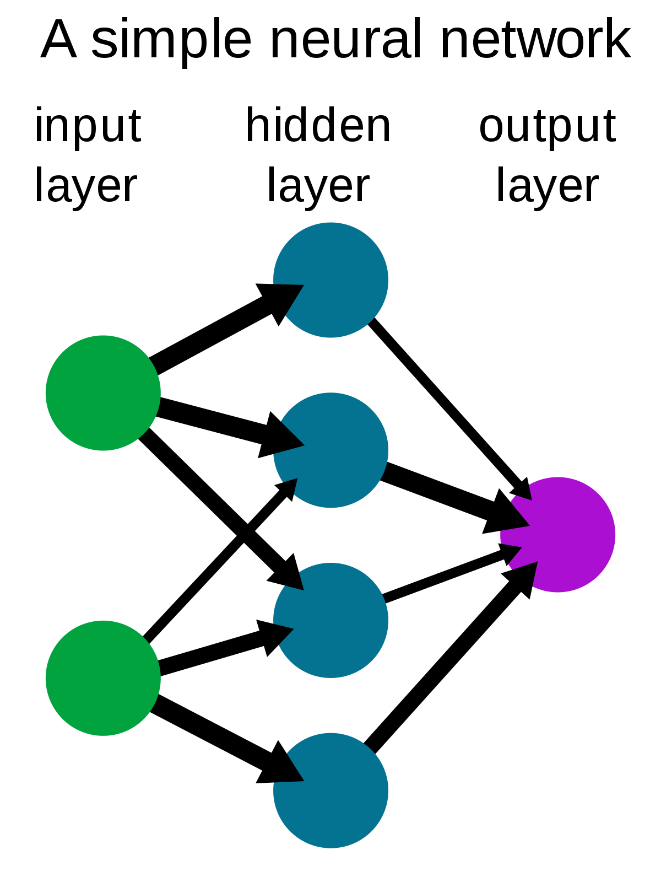

Slide 18
Comparative Analysis
Comparison of Machine Learning algorithms' performance on Sentiment Analysis tasks.
Experimental Results: Accuracy and other performance metrics for each algorithm.

Slide 19
Conclusion
Recap of the comparison of Machine Learning algorithms for Sentiment Analysis.
Understanding the strengths and weaknesses of each algorithm.

Slide 20
References
Cambria, E., Schuller, B., Xia, Y., Havasi, C., & Eck, D. (2018). Affective Computing and Sentiment Analysis: Emotion, Metaphor and Terminology. Cognitive Computation, 10(4), 597-612. doi: 10.1007/s12559-018-9537-3.
Ghosal, A., Chowdhury, S. A., Mondal, S., & Pramanik, S. (2020). Emotion Detection from Text: A Comprehensive Review. In Proceedings of the 9th International Conference on Data Science, Technology and Applications (pp. 315-322). SCITEPRESS.
Gupta, A., & Lehal, G. S. (2018). A Survey of Text Mining Techniques and Applications. Journal of Emerging Technologies in Web Intelligence, 10(1), 60-76. doi: 10.4304/jetwi.10.1.60-76.
Kumar, A., & Sharma, R. (2019). Emotion Detection in Sentiment Analysis: A Survey. International Journal of Computer Applications, 182(3), 31-36. doi: 10.5120/ijca2019919034.

Slide 21
Thank you !

